Slide 1
Machine Learning
PyTorch Tutorial
TA：張恆瑞 (Heng-Jui Chang)
2021.03.05

Slide 2
Outline
Prerequisites
What is PyTorch?
PyTorch v.s. TensorFlow
Overview of the DNN Training Procedure
Tensor
How to Calculate Gradient?
Dataset & Dataloader
torch.nn
torch.optim
Neural Network Training/Evaluation
Saving/Loading a Neural Network
More About PyTorch

Slide 3


Prerequisites
We assume you are already familiar with…
Python3
if-else, loop, function, file IO, class, ...
refs: link1, link2, link3
NumPy
array & array operations
ref: link

Slide 4

What is PyTorch?
An open source machine learning framework.
A Python package that provides two high-level features:
Tensor computation (like NumPy) with strong GPU acceleration
Deep neural networks built on a tape-based autograd system

Slide 5

PyTorch v.s. TensorFlow
 | PyTorch | TensorFlow
Developer | Facebook AI | Google Brain
Interface | Python & C++ | Python, C++, JavaScript, Swift
Debug | Easier | Difficult (easier in 2.0)
Application | Research | Production

Slide 6
Overview of the DNN Training Procedure
torch.nn
torch.optim
Load Data
torch.utils.data.Dataset
torch.utils.data.DataLoader
Define Neural Network
Loss Function
Training
Testing
Optimizer
Validation

Slide 7
Tensor
High-dimensional matrix (array)
1-D tensor
2-D tensor
3-D tensor

Slide 8
Tensor -- Data Type
Data type | dtype | tensor
32-bit floating point | torch.float | torch.FloatTensor
64-bit integer (signed) | torch.long | torch.LongTensor
ref: https://pytorch.org/docs/stable/tensors.html

Slide 9
Tensor -- Shape of Tensors
Shape
4
3
5
3
5
5
(5, )
(3, 5)
(4, 5, 3)
dim 0
dim 0
dim 1
dim 0
dim 1
dim 2
Note: dim in PyTorch == axis in NumPy

Slide 10
Tensor -- Constructor
From list / NumPy array
x = torch.tensor([[1, -1], [-1, 1]])
x = torch.from_numpy(np.array([[1, -1], [-1, 1]]))
Zero tensor
x = torch.zeros([2, 2])
Unit tensor
x = torch.ones([1, 2, 5])
tensor([[1., -1.],
[-1., 1.]])
tensor([[0., 0.],
[0., 0.]])
tensor([[[1., 1., 1., 1., 1.],
[1., 1., 1., 1., 1.]]])
shape

Slide 11
Tensor -- Operators
Squeeze: remove the specified dimension with length = 1
>>> x = torch.zeros([1, 2, 3])
>>> x.shape
torch.Size([1, 2, 3])
>>> x = x.squeeze(0)
>>> x.shape
torch.Size([2, 3])
1
3
2
(dim = 0)
2
3

Slide 12
Tensor -- Operators
Unsqueeze: expand a new dimension
>>> x = torch.zeros([2, 3])
>>> x.shape
torch.Size([2, 3])
>>> x = x.unsqueeze(1)
>>> x.shape
torch.Size([2, 1, 3])
2
3
(dim = 1)
2
3
1

Slide 13
Tensor -- Operators
Transpose: transpose two specified dimensions
>>> x = torch.zeros([2, 3])
>>> x.shape
torch.Size([2, 3])
>>> x = x.transpose(0, 1)
>>> x.shape
torch.Size([3, 2])
2
3
3
2

Slide 14
Tensor -- Operators
x
2
3
1
Cat: concatenate multiple tensors
>>> x = torch.zeros([2, 1, 3])
>>> y = torch.zeros([2, 3, 3])
>>> z = torch.zeros([2, 2, 3])
>>> w = torch.cat([x, y, z], dim=1)
>>> w.shape
torch.Size([2, 6, 3])
y
2
3
3
z
2
3
2
w
2
3
6

Slide 15
Tensor -- Operators
Addition
z = x + y
Subtraction
z = x - y
Power
y = x.pow(2)

Slide 16
Tensor -- Operators
Summation
y = x.sum()
Mean
y = x.mean()
more operators: https://pytorch.org/docs/stable/tensors.html

Slide 17
Tensor -- PyTorch v.s. NumPy
Attributes
PyTorch | NumPy
x.shape | x.shape
x.dtype | x.dtype
ref: https://github.com/wkentaro/pytorch-for-numpy-users

Slide 18
Tensor -- PyTorch v.s. NumPy
Shape manipulation
PyTorch | NumPy
x.reshape / x.view | x.reshape
x.squeeze() | x.squeeze()
x.unsqueeze(1) | np.expand_dims(x, 1)
ref: https://github.com/wkentaro/pytorch-for-numpy-users

Slide 19
Tensor -- Device
Default: tensors & modules will be computed with CPU
CPU
x = x.to(‘cpu’)
GPU
x = x.to(‘cuda’)

Slide 20

Tensor -- Device (GPU)
Check if your computer has NVIDIA GPU
torch.cuda.is_available()
Multiple GPUs: specify ‘cuda:0’, ‘cuda:1’, ‘cuda:2’, ...
Why GPU?
Parallel computing
https://towardsdatascience.com/what-is-a-gpu-and-do-you-need-one-in-deep-learning-718b9597aa0d

Slide 21
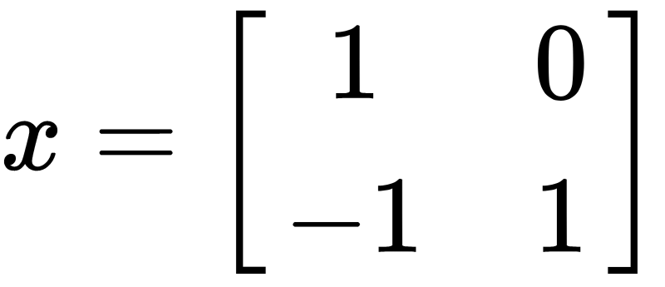
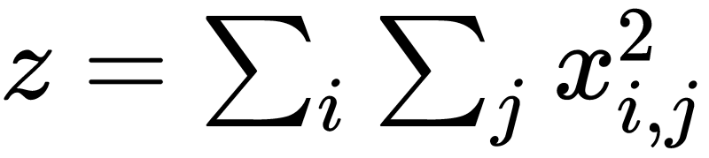
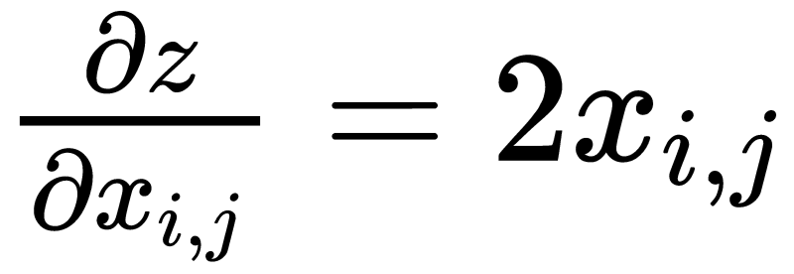
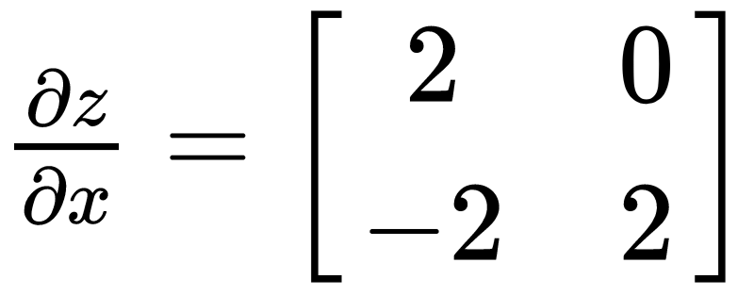
How to Calculate Gradient?
1
>>> x = torch.tensor([[1., 0.], [-1., 1.]], requires_grad=True)
>>> z = x.pow(2).sum()
>>> z.backward()
>>> x.grad
tensor([[ 2., 0.],
[-2., 2.]])
2
3
4
1
2
3
4

Slide 22
Overview of the DNN Training Procedure
torch.nn
torch.optim
Load Data
torch.utils.data.Dataset
torch.utils.data.DataLoader
Define Neural Network
Loss Function
Training
Testing
Optimizer
Validation

Slide 23
Dataset & Dataloader
from torch.utils.data import Dataset, DataLoader
class MyDataset(Dataset):
def __init__(self, file):
self.data = ...
def __getitem__(self, index):
return self.data[index]
def __len__(self):
return len(self.data)
Read data & preprocess
Returns one sample at a time
Returns the size of the dataset

Slide 24
Dataset & Dataloader
Training: True
Testing: False
dataset = MyDataset(file)
dataloader = DataLoader(dataset, batch_size, shuffle=True)
DataLoader
Dataset
__getitem__(0)
0
__getitem__(1)
1
__getitem__(2)
batch_size
2
__getitem__(3)
3
__getitem__(4)
4
mini-batch

Slide 25
Overview of the DNN Training Procedure
torch.nn
torch.optim
Load Data
torch.utils.data.Dataset
torch.utils.data.DataLoader
Define Neural Network
Loss Function
Training
Testing
Optimizer
Validation

Slide 26
torch.nn -- Neural Network Layers
Linear Layer (Fully-connected Layer)
nn.Linear(in_features, out_features)
Input Tensor
* x 32
nn.Linear(32, 64)
Output Tensor
* x 64
can be any shape but the last dimension must be 32
e.g. (10, 32), (10, 5, 32), (1, 1, 3, 32), ...

Slide 27
torch.nn -- Neural Network Layers
Linear Layer (Fully-connected Layer)
y₁
x₁
W
(64x32)
b
y
y₂
x₂
32
x
y₃
64
x
+
=
x₃
...
...
x₃₂
y₆₄

Slide 28
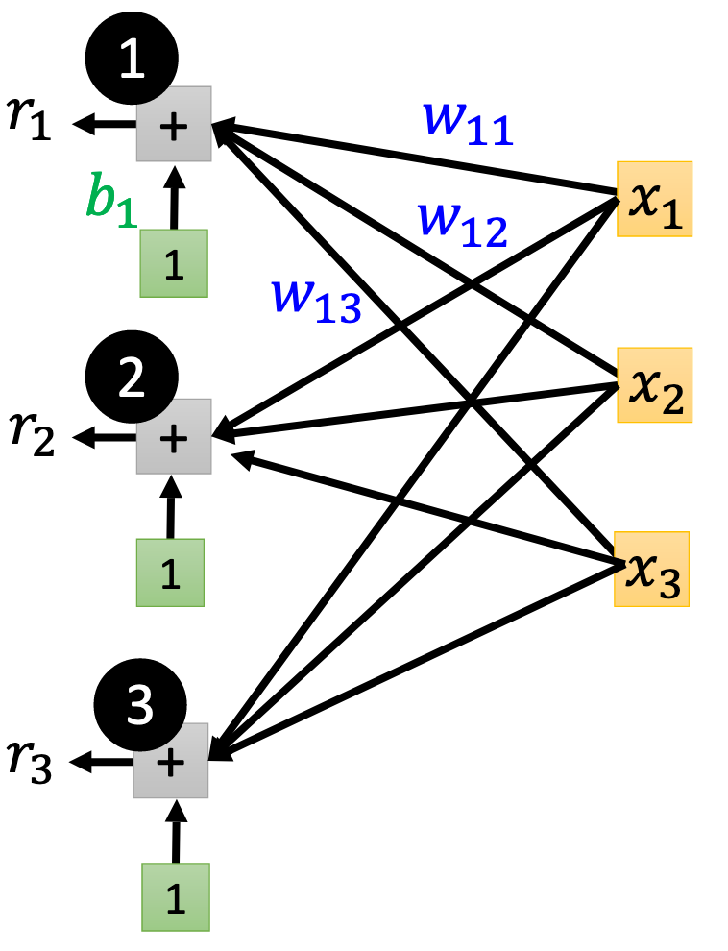
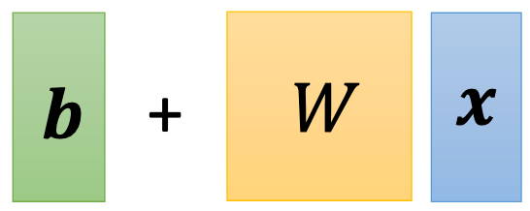
torch.nn -- Neural Network Layers
Linear Layer (Fully-connected Layer)

Slide 29
torch.nn -- Neural Network Layers
Linear Layer (Fully-connected Layer)
>>> layer = torch.nn.Linear(32, 64)
>>> layer.weight.shape
torch.Size([64, 32])
>>> layer.bias.shape
torch.Size([64])
W
(64x32)
b
y
x
x
+
=

Slide 30
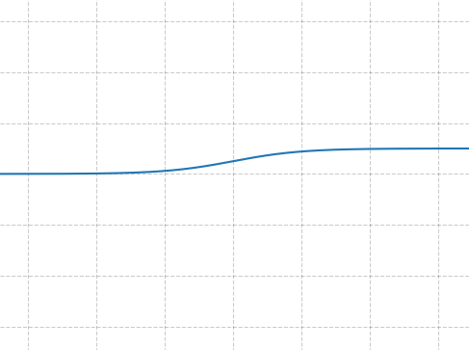
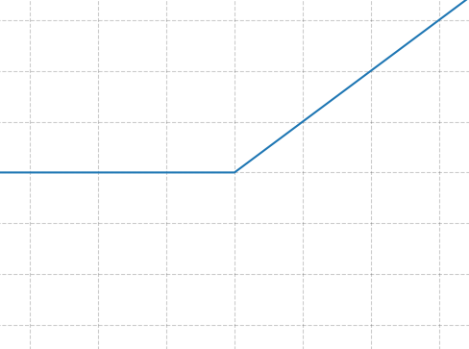
torch.nn -- Activation Functions
Sigmoid Activation
nn.Sigmoid()
ReLU Activation
nn.ReLU()

Slide 31
Overview of the DNN Training Procedure
torch.nn
torch.optim
Load Data
torch.utils.data.Dataset
torch.utils.data.DataLoader
Define Neural Network
Loss Function
Training
Testing
Optimizer
Validation

Slide 32
torch.nn -- Loss Functions
Mean Squared Error (for linear regression)
nn.MSELoss()
Cross Entropy (for classification)
nn.CrossEntropyLoss()

Slide 33
torch.nn -- Build your own neural network
import torch.nn as nn
class MyModel(nn.Module):
def __init__(self):
super(MyModel, self).__init__()
self.net = nn.Sequential(
nn.Linear(10, 32),
nn.Sigmoid(),
nn.Linear(32, 1)
)
def forward(self, x):
return self.net(x)
Initialize your model & define layers
Compute output of your NN

Slide 34
torch.nn -- Build your own neural network
1
import torch.nn as nn
class MyModel(nn.Module):
def __init__(self):
super(MyModel, self).__init__()
self.net = nn.Sequential(
nn.Linear(10, 32),
nn.Sigmoid(),
nn.Linear(32, 1)
)
def forward(self, x):
return self.net(x)
Linear
Sigmoid
32
Linear
10

Slide 35
Overview of the DNN Training Procedure
torch.nn
torch.optim
Load Data
torch.utils.data.Dataset
torch.utils.data.DataLoader
Define Neural Network
Loss Function
Training
Testing
Optimizer
Validation

Slide 36
torch.optim
Optimization algorithms for neural networks (gradient descent)
Stochastic Gradient Descent (SGD)
torch.optim.SGD(params, lr, momentum = 0)
model.parameters()

Slide 37
Overview of the DNN Training Procedure
torch.nn
torch.optim
Load Data
torch.utils.data.Dataset
torch.utils.data.DataLoader
Define Neural Network
Loss Function
Training
Testing
Optimizer
Validation

Slide 38
Neural Network Training
dataset = MyDataset(file)
tr_set = DataLoader(dataset, 16, shuffle=True)
model = MyModel().to(device)
criterion = nn.MSELoss()
optimizer = torch.optim.SGD(model.parameters(), 0.1)
read data via MyDataset
put dataset into Dataloader
contruct model and move to device (cpu/cuda)
set loss function
set optimizer

Slide 39
Neural Network Training
for epoch in range(n_epochs):
model.train()
for x, y in tr_set:
optimizer.zero_grad()
x, y = x.to(device), y.to(device)
pred = model(x)
loss = criterion(pred, y)
loss.backward()
optimizer.step()
iterate n_epochs
set model to train mode
iterate through the dataloader
set gradient to zero
move data to device (cpu/cuda)
forward pass (compute output)
compute loss
compute gradient (backpropagation)
update model with optimizer

Slide 40
Neural Network Evaluation (Validation Set)
model.eval()
total_loss = 0
for x, y in dv_set:
x, y = x.to(device), y.to(device)
with torch.no_grad():
pred = model(x)
loss = criterion(pred, y)
total_loss += loss.cpu().item() * len(x)
avg_loss = total_loss / len(dv_set.dataset)
set model to evaluation mode
iterate through the dataloader
move data to device (cpu/cuda)
disable gradient calculation
forward pass (compute output)
compute loss
accumulate loss
compute averaged loss

Slide 41
Neural Network Evaluation (Testing Set)
model.eval()
preds = []
for x in tt_set:
x = x.to(device)
with torch.no_grad():
pred = model(x)
preds.append(pred.cpu())
set model to evaluation mode
iterate through the dataloader
move data to device (cpu/cuda)
disable gradient calculation
forward pass (compute output)
collect prediction

Slide 42
Save/Load a Neural Network
Save
torch.save(model.state_dict(), path)
Load
ckpt = torch.load(path)
model.load_state_dict(ckpt)

Slide 43
More About PyTorch
torchaudio
speech/audio processing
torchtext
natural language processing
torchvision
computer vision
skorch
scikit-learn + pyTorch

Slide 44
More About PyTorch
Useful github repositories using PyTorch
Huggingface Transformers (transformer models: BERT, GPT, ...)
Fairseq (sequence modeling for NLP & speech)
ESPnet (speech recognition, translation, synthesis, ...)
Many implementation of papers
...

Slide 45
Reference
https://pytorch.org/
https://github.com/pytorch/pytorch
https://github.com/wkentaro/pytorch-for-numpy-users
https://blog.udacity.com/2020/05/pytorch-vs-tensorflow-what-you-need-to-know.html
https://www.tensorflow.org/
https://numpy.org/

Slide 46
Any questions?

